Slide 1


Data-Intensive Computing with MapReduce
Session 8: Sequence Labeling
Jimmy Lin
University of Maryland
Thursday, March 14, 2013
This work is licensed under a Creative Commons Attribution-Noncommercial-Share Alike 3.0 United States See http://creativecommons.org/licenses/by-nc-sa/3.0/us/ for details

Slide 2

Source: Wikipedia (The Scream)

Slide 3
Today’s Agenda
Sequence labeling
Midterm
Final projects

Slide 4
Sequences Everywhere!
Examples of sequences
Waveforms in utterances
Letters in words
Words in sentences
Bases in DNA
Proteins in amino acids
Actions in video
Closing prices in the stock market
All share the property of having structural dependencies

Slide 5
Sequence Labeling
Given a sequence of observations, assign a label to each observation
Observations can be discrete or continuous, scalar or vector
Assume labels are drawn from a discrete finite set
Sample applications:
Speech recognition
POS tagging
Handwriting recognition
Video analysis
Protein secondary structure detection

Slide 6
Approaches
Treat as a classification problem?
Make decisions about each observation independently
Can we do better?
As with before, lots of background material before we get to MapReduce!

Slide 7
MapReduce Implementation: Mapper

Slide 8
MapReduce Implementation: Reducer

Slide 9
Finite State Machines
Q: a finite set of N states
Q = {q₀, q₁, q₂, q₃, …}
The start state: q₀
The set of final states: q_{F}
Σ: a finite input alphabet of symbols
δ(q,i): transition function
Given state q and input symbol i, transition to new state q'

Slide 10

Finite number of states

Slide 11
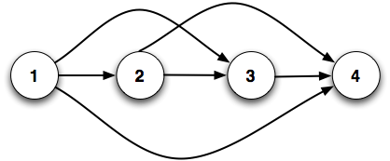
Transitions

Slide 12
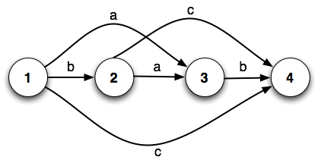
Input alphabet

Slide 13
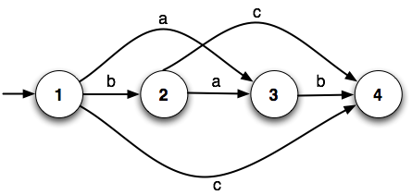
Start state

Slide 14

Final state(s)

Slide 15
What can we do with FSMs?
Generate valid sequences
Accept valid sequences

Slide 16
Weighted FSMs
FSMs treat all transitions as equally likely
What if we know more about state transitions?
‘a’ is twice as likely to be seen in state 1 as ‘b’ or ‘c’
‘c’ is three times as likely to be seen in state 2 as ‘a’
What do we get out of it?
score(‘ab’) = 2
score(‘bc’) = 3
2
3
1
1
1
1

Slide 17
Probabilistic FSMs
= Markov Chains
Let’s replace weights with probabilities
What if we know more about state transitions?
‘a’ is twice as likely to be seen in state 1 as ‘b’ or ‘c’
‘c’ is three times as likely to be seen in state 2 as ‘a’
What do we get out of it?
P(‘ab’) = 0.5
P(‘bc’) = 0.1875
0.5
0.75
0.25
0.25
1.0
0.25

Slide 18
Specifying Markov Chains
Q: a finite set of N states
Q = {q₀, q₁, q₂, q₃, …}
The start state
An explicit start state: q₀
Alternatively, a probability distribution over start states: {π₁, π₂, π₃, …}, Σ π_{i} = 1
The set of final states: q_{F}
N × N Transition probability matrix A = [a_{ij}]
a_{ij} = P(q_{j}|q_{i}), Σ a_{ij} = 1 ∀i
0.5
0.75
0.25
0.25
1.0
0.25

Slide 19
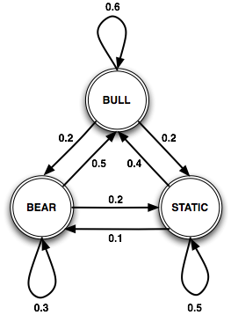
Let’s model the stock market…
What’s special about this FSM?
Present state only depends on the previous state!
The (1st order) Markov assumption
Each state corresponds to a physical state in the world
0.2
What’s missing?
Add “priors”
0.5
0.3

Slide 20
Are states always observable ?
Day:
1 2 3 4 5 6
Not observable !
Bull: Bull Market
Bear: Bear Market
S: Static Market
Bull
Bear
S
Bear
S
Bull
Here’s what you actually observe:
↑: Market is up
↓: Market is down
↔: Market hasn’t changed
↑ ↓ ↔ ↑ ↓ ↔

Slide 21
Hidden Markov Models
Markov chains aren’t enough!
What if you can’t directly observe the states?
We need to model problems where observations don’t directly correspond to states…
Solution: Hidden Markov Model (HMM)
Assume two probabilistic processes
Underlying process (state transition) is hidden
Second process generates sequence of observed events

Slide 22
Specifying HMMs
An HMM is characterized by:
N states:
N x N Transition probability matrix
V observation symbols:
N x |V| Emission probability matrix
Prior probabilities vector

Slide 23

Stock Market HMM
States?
✓
Transitions?
Vocabulary?
Emissions?
Priors?

Slide 24
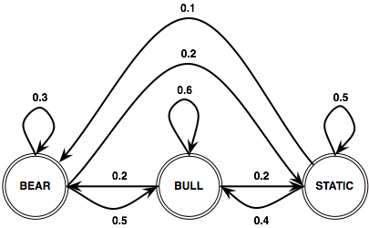
Stock Market HMM
States?
✓
Transitions?
✓
Vocabulary?
Emissions?
Priors?

Slide 25

Stock Market HMM
States?
✓
Transitions?
✓
Vocabulary?
✓
Emissions?
Priors?

Slide 26
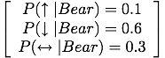
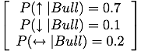
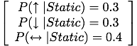
Stock Market HMM
States?
✓
Transitions?
✓
Vocabulary?
✓
Emissions?
✓
Priors?

Slide 27
Stock Market HMM
States?
✓
Transitions?
✓
Vocabulary?
✓
Emissions?
✓
Priors?
✓
π₁=0.5
π₂=0.2
π₃=0.3

Slide 28
Properties of HMMs
Markov assumption:
Output independence:
Remember, these are distinct:
Number of states (N)
The number of distinct observation symbols (V)
The length of the sequence (T)

Slide 29
“Running” an HMM
Set t = 1, select initial state based on
Select an observation to emit based on
If t = T, then done
Select transition into a new state based on
Set t = t + 1
Goto step 2

Slide 30
HMMs: Three Problems
Likelihood: Given an HMM λ and a sequence of observed events O, find the likelihood of observing the sequence
Decoding: Given an HMM λ and an observation sequence O, find the most likely (hidden) state sequence
Learning: Given a set of observation sequences, learn the parameters A and B for λ
Okay, but where did the structure of the HMM come from?

Slide 31
HMM Problem #1: Likelihood

Slide 32
Computing Likelihood
π₃=0.3
t | 1 | 2 | 3 | 4 | 5 | 6
O | ↑ | ↓ | ↔ | ↑ | ↓ | ↔
π₁=0.5
π₂=0.2
Given this model of the stock market, how likely are we to observe the sequence of outputs?

Slide 33
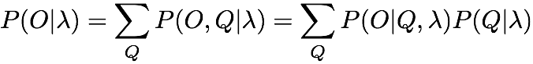
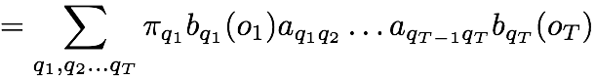
Computing Likelihood
Easy, right?
Sum over all possible ways in which we could generate O from λ
What’s the problem?
Right idea, wrong algorithm!
Takes O(N^{T}) time to compute!

Slide 34
Computing Likelihood
What are we doing wrong?
State sequences may have a lot of overlap
We’re recomputing the shared subsequences every time
Let’s store intermediate results and reuse them
Sounds like a job for dynamic programming!

Slide 35
Forward Algorithm
Forward probability
Probability of being in state j after t observations
Build an N × T trellis
Intuition: forward probability only depends on the previous state and observation
…
…
…
…
…
…

Slide 36
Forward Algorithm
Initialization
Recursion
Termination
. . . .

Slide 37
Forward Algorithm
O =
↑ ↓ ↑
find

Slide 38
Forward Algorithm
Static
states
Bear
Bull
↑
↓
↑
t=1
t=2
t=3
time

Slide 39
Forward Algorithm: Initialization
0.3×0.3
=0.09
Static
α₁(Static)
states
0.5×0.1
=0.05
Bear
α₁(Bear)
0.2×0.7=0.14
Bull
α₁(Bull)
↑
↓
↑
t=1
t=2
t=3
time

Slide 40
Forward Algorithm: Recursion
0.3×0.3
=0.09
Static
0.5×0.1
=0.05
.... and so on
states
Bear
0.09×0.4×0.1=0.0036
0.05×0.5×0.1=0.0025
0.2×0.7=0.14
0.0145
Bull
0.14×0.6×0.1=0.0084
α₁(Bull)×a_{BullBull}×b_{Bull}(↓)
↑
↓
↑
t=1
t=2
t=3
time

Slide 41
Forward Algorithm: Recursion
0.3×0.3
=0.09
0.0249
0.006477
Static
states
0.5×0.1
=0.05
0.0312
0.001475
Bear
0.2×0.7=0.14
0.0145
0.024
Bull
↑
↓
↑
t=1
t=2
t=3
time

Slide 42
Forward Algorithm: Termination
0.3×0.3
=0.09
0.0249
0.006477
Static
states
0.5×0.1
=0.05
0.0312
0.001475
Bear
0.2×0.7=0.14
0.0145
0.024
Bull
↑
↓
↑
t=1
t=2
t=3
P(O) = 0.03195
time

Slide 43
HMM Problem #2: Decoding

Slide 44
Decoding
π₃=0.3
t | 1 | 2 | 3 | 4 | 5 | 6
O | ↑ | ↓ | ↔ | ↑ | ↓ | ↔
π₁=0.5
π₂=0.2
Given this model of the stock market, what are the most likely states the market went through to produce O?

Slide 45
Decoding
“Decoding” because states are hidden
First try:
Compute P(O) for all possible state sequences, then choose sequence with highest probability
What’s the problem here?
Second try:
For each possible hidden state sequence, compute P(O) using the forward algorithm
What’s the problem here?

Slide 46
Viterbi Algorithm
“Decoding” = computing most likely state sequence
Another dynamic programming algorithm
Efficient: polynomial vs. exponential
Same idea as the forward algorithm
Store intermediate computation results in a trellis
Build new cells from existing cells

Slide 47
Viterbi Algorithm
Viterbi probability
Probability of being in state j after seeing t observations and passing through the most likely state sequence so far
Build an N × T trellis
Intuition: forward probability only depends on the previous state and observation
…
…
…
…
…
…

Slide 48
Viterbi vs. Forward
Maximization instead of summation over previous paths
This algorithm is still missing something!
In forward algorithm, we only care about the probabilities
What’s different here?
We need to store the most likely path (transition):
Use “backpointers” to keep track of most likely transition
At the end, follow the chain of backpointers to recover the most likely state sequence

Slide 49
Viterbi Algorithm: Formal Definition
Initialization
Recursion
Termination
Why no b() ?

Slide 50
Viterbi Algorithm
O =
↑ ↓ ↑
find most likely state sequence

Slide 51
Viterbi Algorithm
Static
states
Bear
Bull
↑
↓
↑
t=1
t=2
t=3
time

Slide 52
Viterbi Algorithm: Initialization
0.3×0.3
=0.09
Static
v₁(Static)
states
0.5×0.1
=0.05
Bear
v₁(Bear)
0.2×0.7=0.14
Bull
v₁(Bull)
↑
↓
↑
t=1
t=2
t=3
time

Slide 53
Viterbi Algorithm: Recursion
0.3×0.3
=0.09
Static
states
0.5×0.1
=0.05
0.09×0.4×0.1=0.0036
Bear
0.05×0.5×0.1=0.0025
Max
0.2×0.7=0.14
0.0084
Bull
0.14×0.6×0.1=0.0084
v₁(Bull)×a_{BullBull}×b_{Bull}(↓)
↑
↓
↑
t=1
t=2
t=3
time

Slide 54
Viterbi Algorithm: Recursion
0.3×0.3
=0.09
Static
0.5×0.1
=0.05
.... and so on
states
Bear
store backpointer
0.2×0.7=0.14
0.0084
Bull
↑
↓
↑
t=1
t=2
t=3
time

Slide 55
Viterbi Algorithm: Recursion
0.3×0.3
=0.09
0.0135
0.00202
Static
states
0.5×0.1
=0.05
0.0168
0.000504
Bear
0.2×0.7=0.14
0.0084
0.00588
Bull
↑
↓
↑
t=1
t=2
t=3
time

Slide 56
Viterbi Algorithm: Termination
0.3×0.3
=0.09
0.0135
0.00202
Static
states
0.5×0.1
=0.05
0.0168
0.000504
Bear
0.2×0.7=0.14
0.0084
0.00588
Bull
↑
↓
↑
t=1
t=2
t=3
time

Slide 57
Viterbi Algorithm: Termination
0.3×0.3
=0.09
0.0135
0.00202
Static
Most likely state sequence:
[ Bull, Bear, Bull ], P = 0.00588
states
0.5×0.1
=0.05
0.0168
0.000504
Bear
0.2×0.7=0.14
0.0084
0.00588
Bull
↑
↓
↑
t=1
t=2
t=3
time

Slide 58
HMM Problem #3: Learning

Slide 59
The Problem
Given training data, learn parameters for the HMM
A: transition probabilities
B: emission probabilities
Two cases:
Supervised training: sequences where observations are paired with states
Unsupervised training: sequences with observations only

Slide 60
Supervised Training
Easy! Just like relative frequency counting
Compute maximum likelihood estimates directly from data
Transition probabilities:
Emission probabilities:

Slide 61
Supervised Training
Easy! Just like relative frequency counting
Remember the usual MapReduce tricks:
Pairs vs. stripes for keep track of joint counts
Combiners and in-mapper combining apply

Slide 62
Unsupervised Training
Hard!
Actually, it’s not that bad…
Pseudo-counts instead of counts
More complex bookkeeping

Slide 63
Unsupervised Training
What’s the fundamental problem?
Chick-and-egg problem:
If we knew what the hidden variables were, then computing the model parameters would be easy
If we knew the model parameters, we’d be able to compute the hidden variables (but of course, that’s the whole point)
Where have we seen this before?

Slide 64
EM to the Rescue!
Start with initial parameters
Iterate until convergence:
E-step: Compute posterior distribution over latent (hidden) variables given the model parameters
M-step: Update model parameters using posterior distribution computed in the E-step
How does this work for HMMs?
First, we need one more definition…

Slide 65
Backward Algorithm
Backward probability
Probability of seeing observations from time t+1 to T given that we’re in state j at time t
Guess what? Build an N × T trellis
…
…
…
…
…
…

Slide 66
Backward Algorithm
Initialization
Recursion
Termination
. . . .

Slide 67
Backward Algorithm
Static
states
Bear
Bull
↑
↓
↑
t=1
t=2
t=3
time

Slide 68
Backward Algorithm: Initialization
1.0
Static
states
1.0
Bear
1.0
Bull
↑
↓
↑
t=1
t=2
t=3
time

Slide 69
Backward Algorithm: Recursion
0.0135
1.0
Static
states
1.0
Bear
.... and so on
1.0
Bull
↑
↓
↑
t=1
t=2
t=3
time

Slide 70
Backward Algorithm: Recursion
0.1124
0.44
1.0
Static
states
0.1306
0.44
1.0
Bear
0.1092
0.5
1.0
Bull
↑
↓
↑
t=1
t=2
t=3
time

Slide 71
Forward-Backward
Forward probability
Probability of being in state j after t observations
Backward probability
Probability of seeing observations from time t+1 to T given that we’re in state j at time t
Neat Observation:

Slide 72
Forward-Backward
0.1124
0.44
1.0
Static
0.09
0.0249
0.006477
states
0.1306
0.44
1.0
Bear
0.05
0.0312
0.001475
0.1092
0.5
1.0
Bull
0.14
0.0145
0.024
↑
↓
↑
t=1
t=2
t=3
time

Slide 73
Forward-Backward
. . . .
. . . .

Slide 74
Estimating Emissions Probabilities
Basic idea:
Let’s define:
Thus:
expected number of times in state j and observing symbol v_{k}
b_{j}(v_{k}) =
expected number of times in state j

Slide 75
Forward-Backward
. . . .
. . . .

Slide 76
Estimating Transition Probabilities
Basic idea:
Let’s define:
Thus:
expected number of transitions from state i to state j
a_{ij} =
expected number of transitions from state i

Slide 77
MapReduce Implementation: Mapper

Slide 78
MapReduce Implementation: Reducer

Slide 79
Implementation Notes
Standard setup of iterative MapReduce algorithms
Driver program sets up MapReduce job
Waits for completion
Checks for convergence
Repeats if necessary
Additional details:
Must load and serialize model parameters at each iteration
Reducer receives 2N + 1 keys, so limits to reducer parallelization
Iteration overhead less than other iterative algorithms

Slide 80

Questions?
Source: Wikipedia (Japanese rock garden)

Slide 81
Midterm

Slide 82
Final Projects
Anything in the big data space
Teams of 2-3 people
Available data resources
Available cluster resources
Project Ideas?

